Slide 1

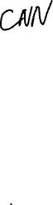
Convolutional Neural Networks Lesson-06
李老师& 开课吧人工智能学院课程组
2020.02.

Slide 2
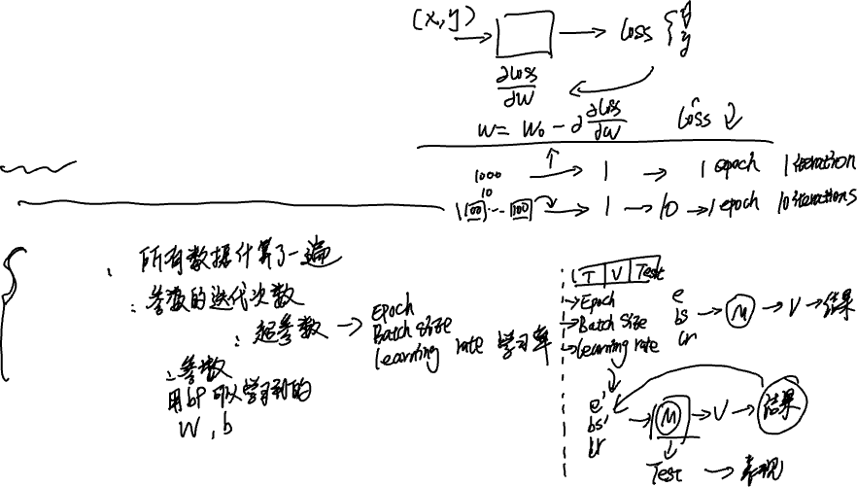
Recap of ANN
Froward and backward propagations
SGD
Training scheme and some training tips
Some terminologies
Epoch
Iteration
Hyperparameters
Parameters

Slide 3
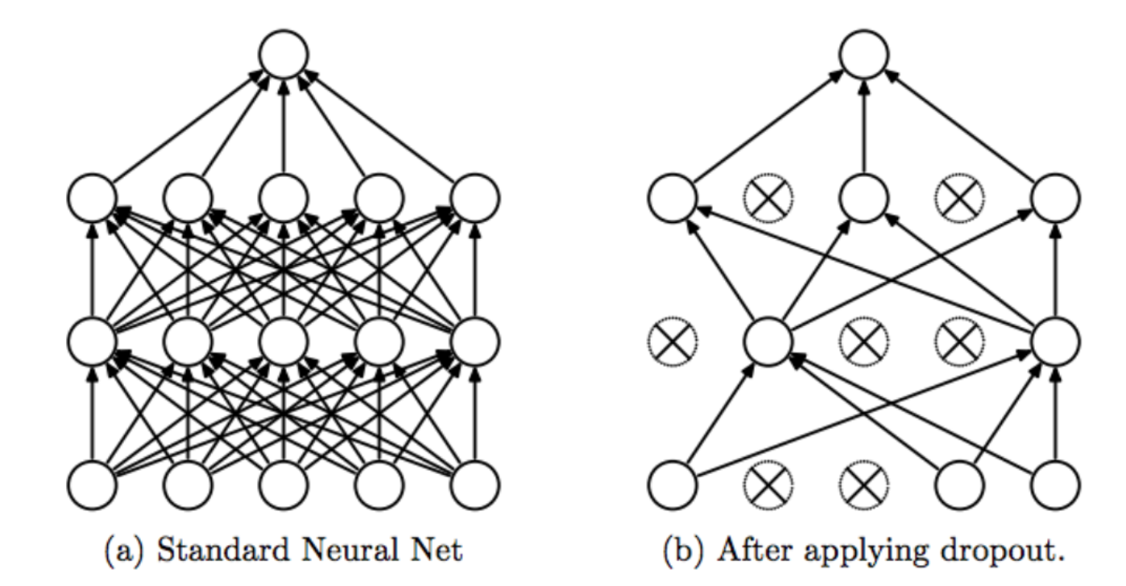
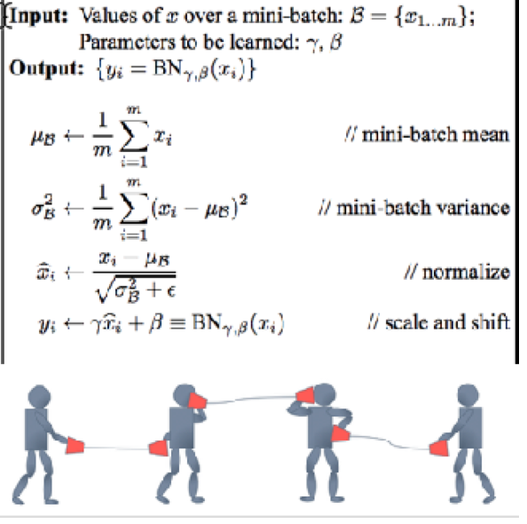
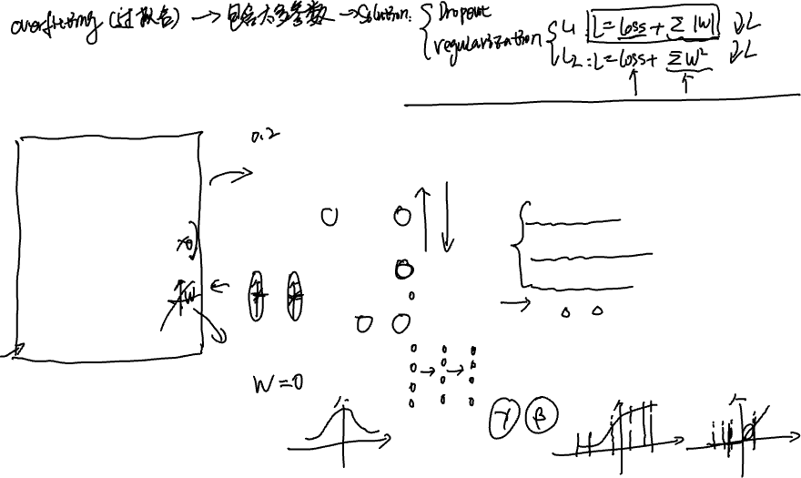
Some training tips

Slide 4
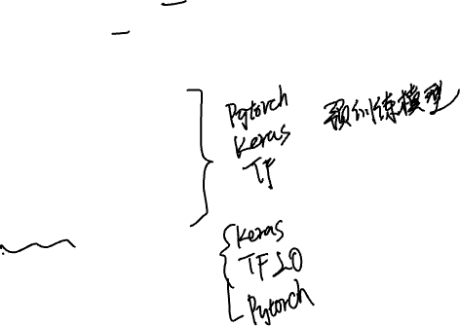
overview
Convolutional Neural Networks
What is CNN.
Pooling
Training tips
Some Famous CNN Models
LetNet
AlexNet
GoogleNet
VGG, ResNet
DenseNet
Coding
Introduction of keras

Slide 5
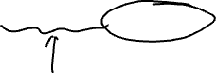
Convolutional Neural Networks references: Deep learning chapter 9

Slide 6
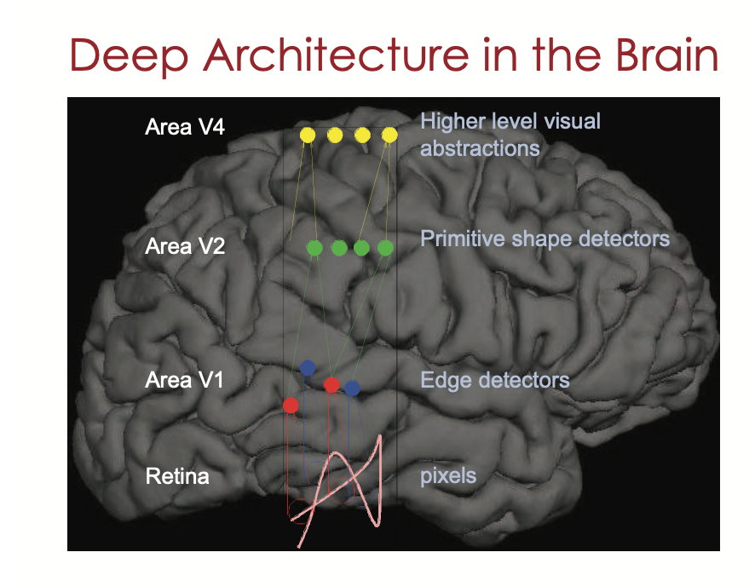
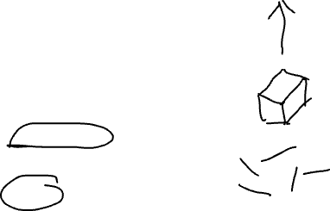

Slide 7
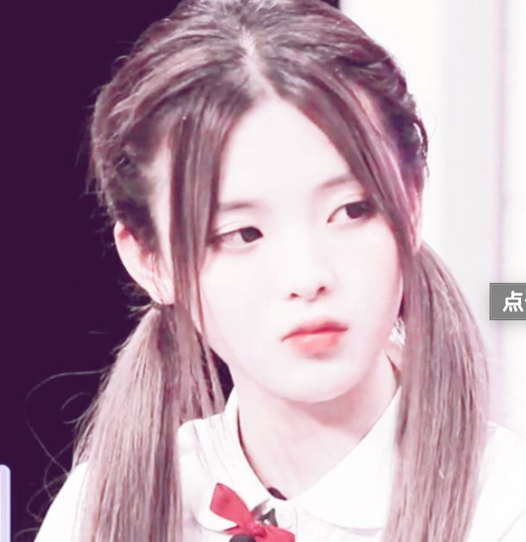
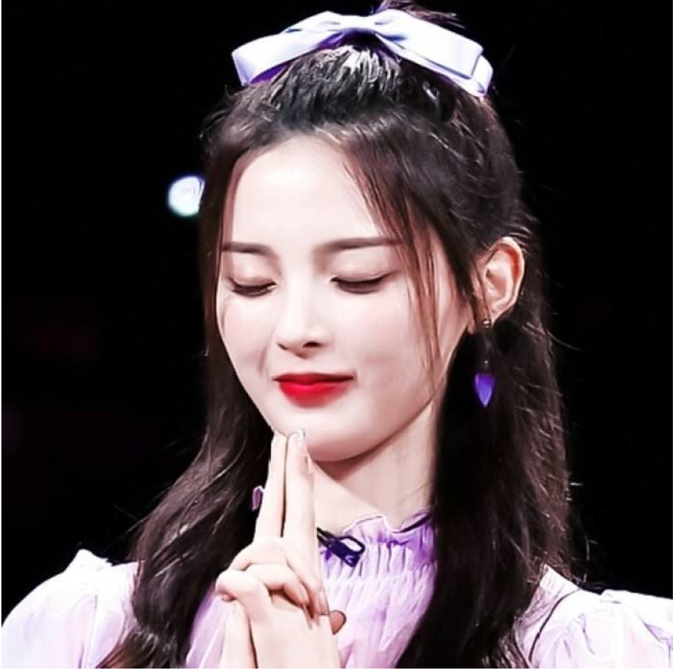
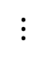
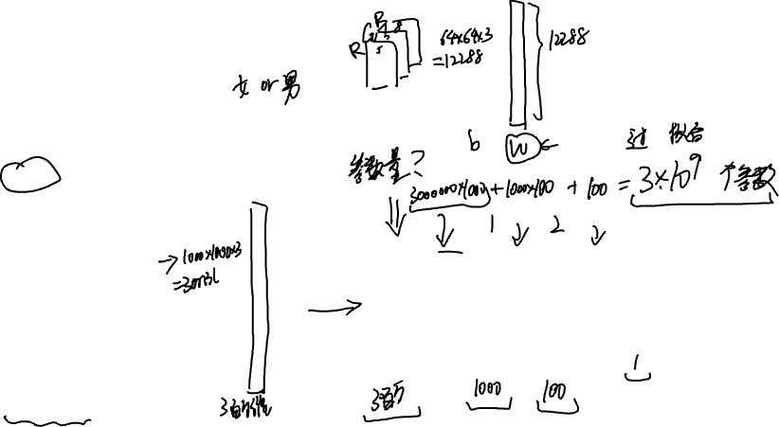
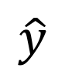
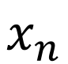
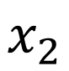
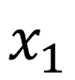
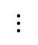
How did we handle images in previous lectures?
Female? (0/1)
64x64
$$x_{1}$$
$$x_{2}$$
$$⋮$$
$$⋮$$
$$⋮$$
$$\hat{y}$$
$$x_{n}$$
1000x1000

Slide 8
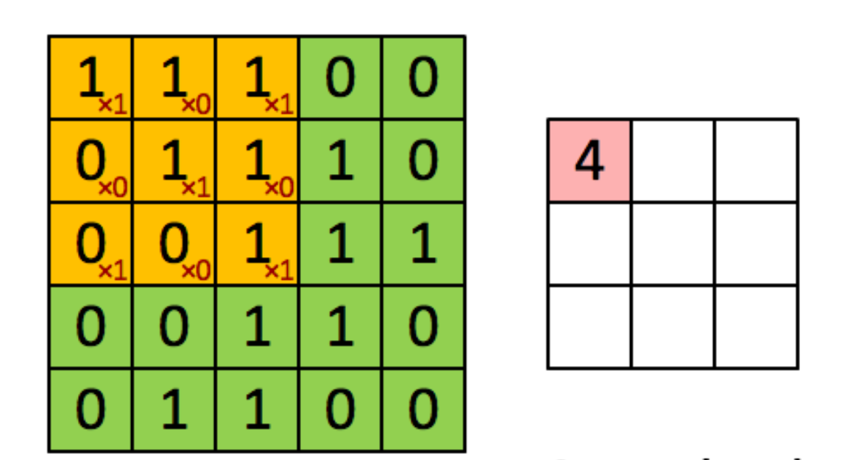

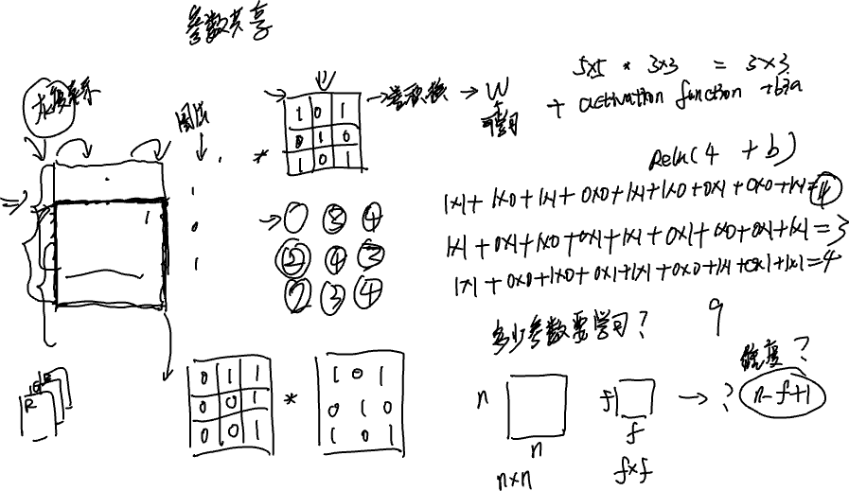





CNNs (parameters sharing)

Slide 9
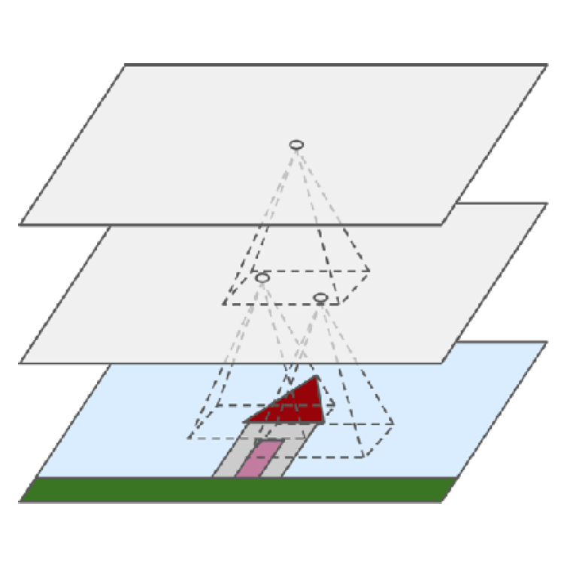
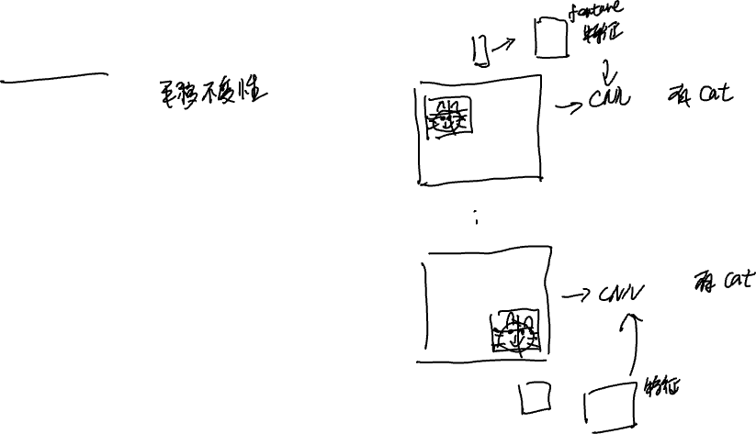
CNNs (Local invariant)

Slide 10
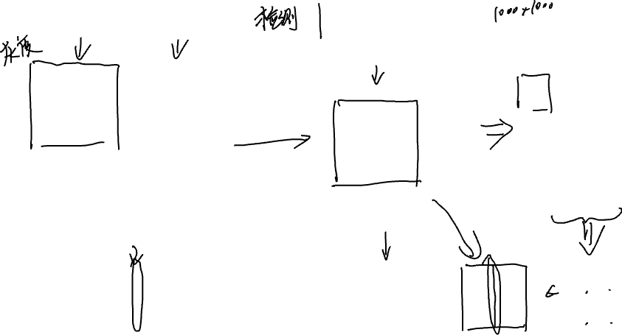
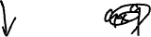
Feature detection
10 | 10 | 10 | 0 | 0 | 0
10 | 10 | 10 | 0 | 0 | 0
10 | 10 | 10 | 0 | 0 | 0
10 | 10 | 10 | 0 | 0 | 0
10 | 10 | 10 | 0 | 0 | 0
10 | 10 | 10 | 0 | 0 | 0
0 | 30 | 30 | 0
0 | 30 | 30 | 0
0 | 30 | 30 | 0
0 | 30 | 30 | 0
1 | 0 | -1
1 | 0 | -1
1 | 0 | -1

Slide 11

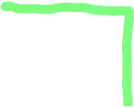



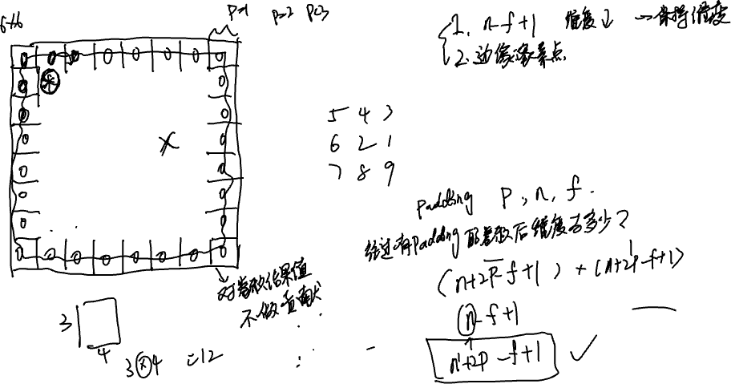

More about CNNs. (padding 1)

Slide 12
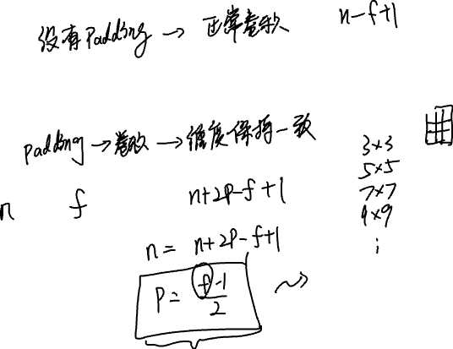
More about CNNs. (padding 2)
“Valid Padding”:
“Same Padding”:

Slide 13
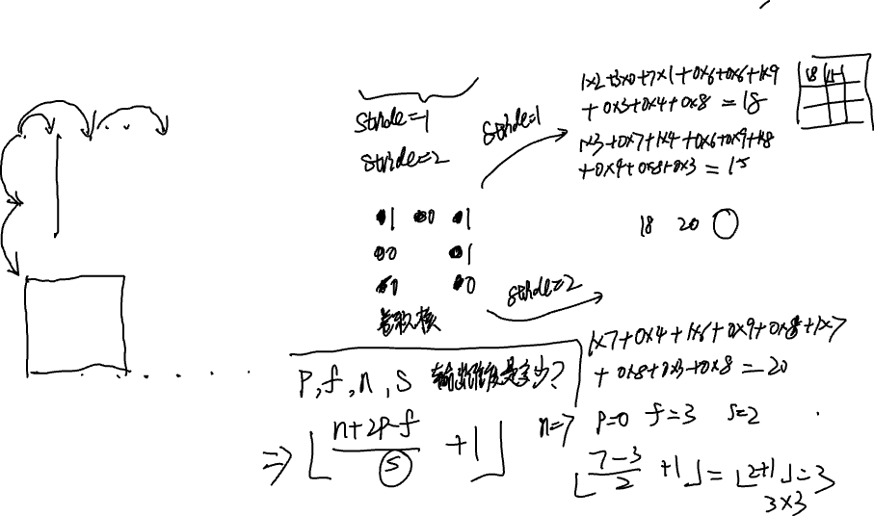





More about CNNs (strides)
2 | 3 | 7 | 4 | 6 | 2 | 9
6 | 6 | 9 | 8 | 7 | 4 | 3
3 | 4 | 8 | 3 | 8 | 9 | 7
7 | 8 | 3 | 6 | 6 | 3 | 4
4 | 2 | 1 | 8 | 3 | 4 | 6
3 | 2 | 4 | 1 | 9 | 8 | 3
0 | 1 | 3 | 9 | 2 | 1 | 4
3 | 4 | 4
1 | 0 | 2
-1 | 0 | 3

Slide 14
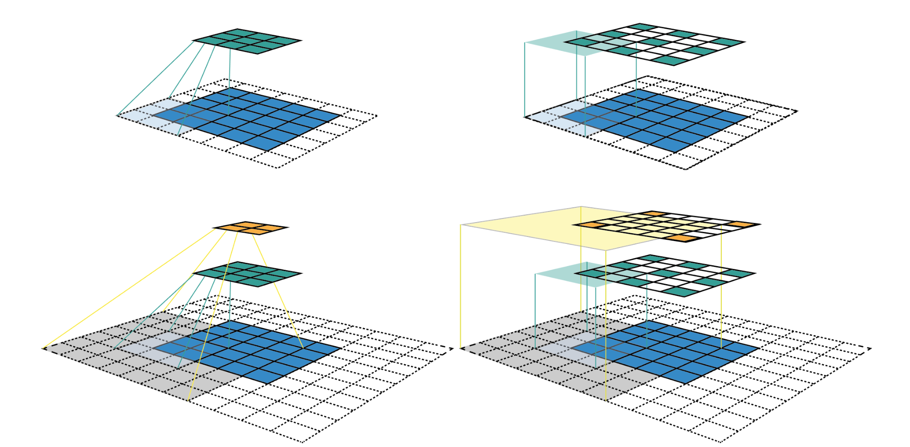

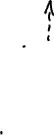

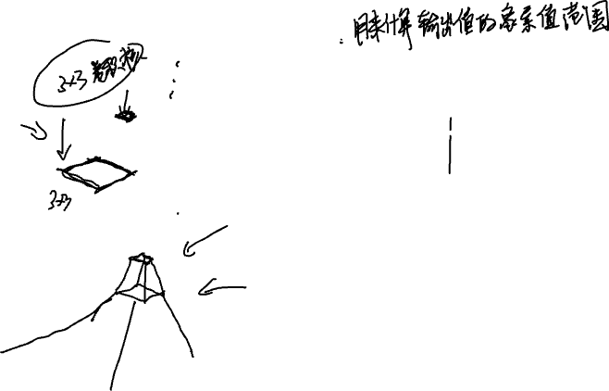

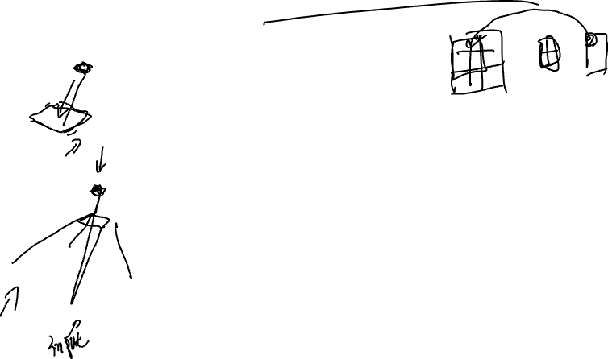
What is receptive field ?

Slide 15
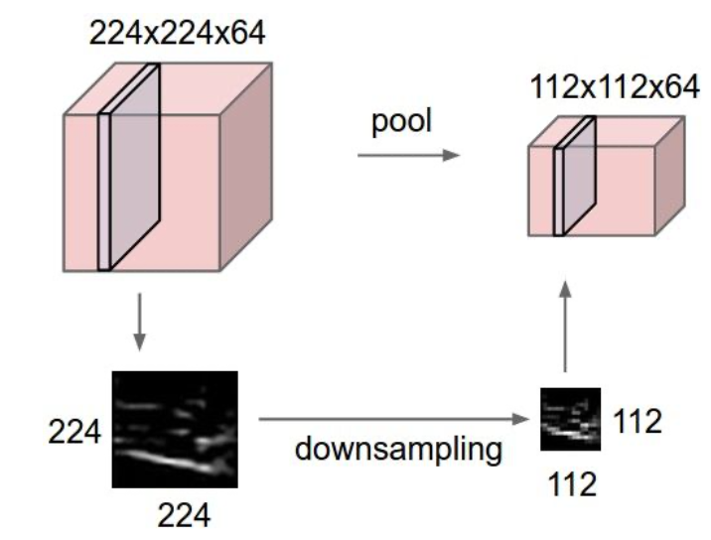
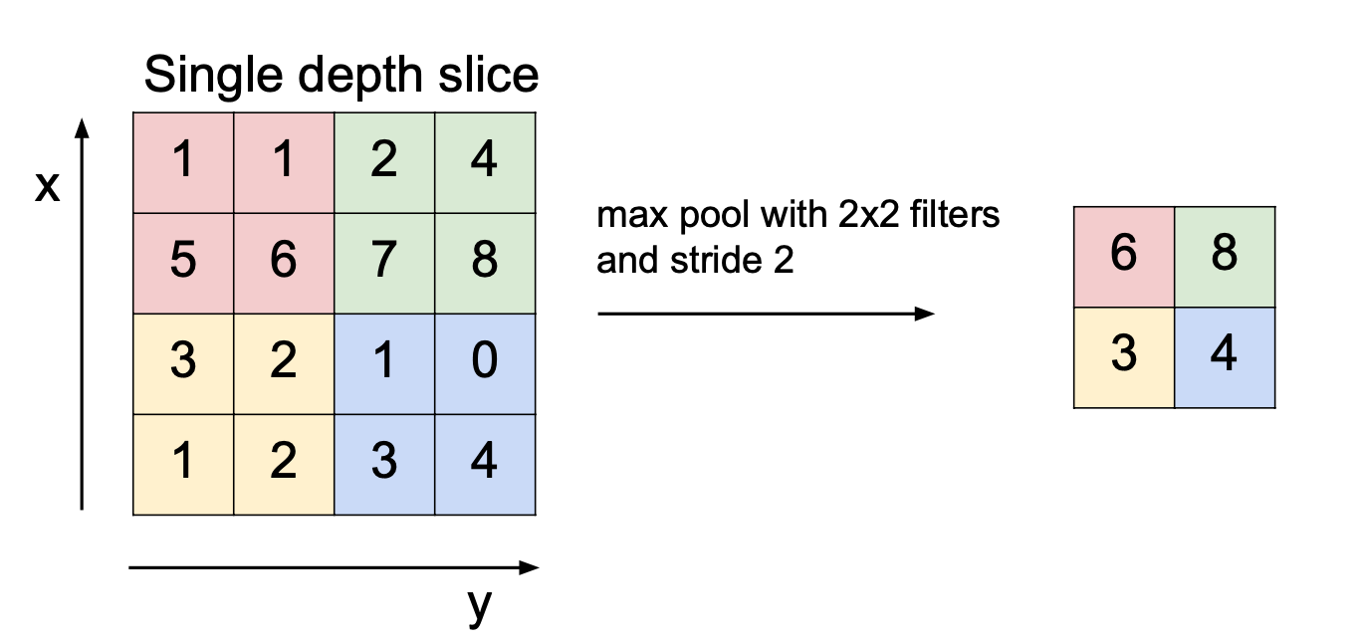
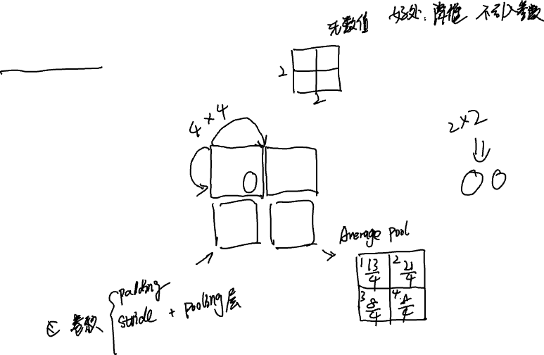
What pooling layers do ?

Slide 16
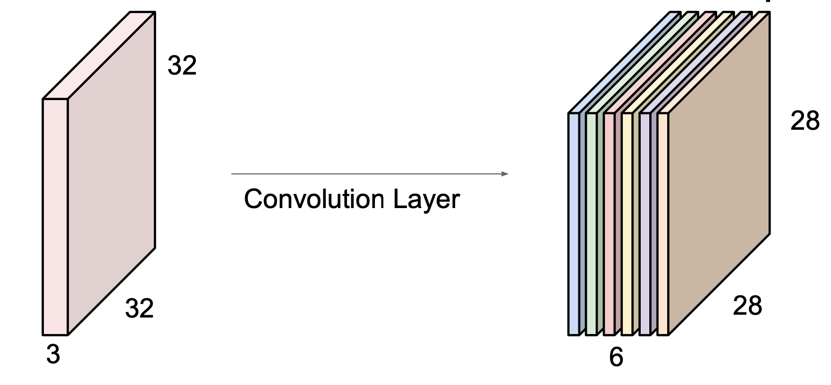
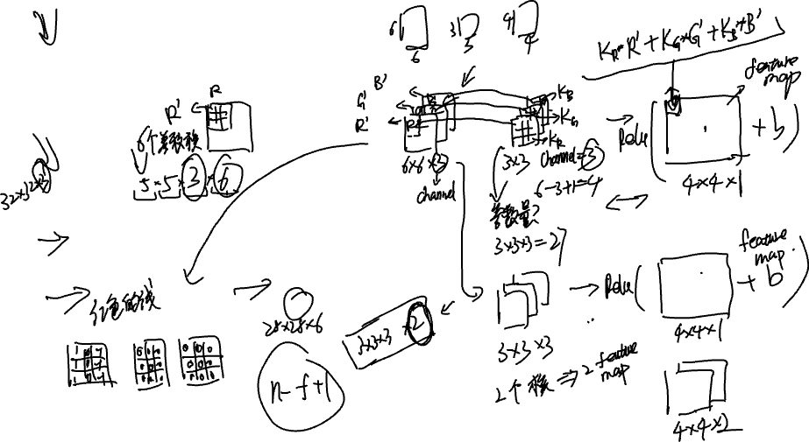
More about CNNs (feature maps)

Slide 17
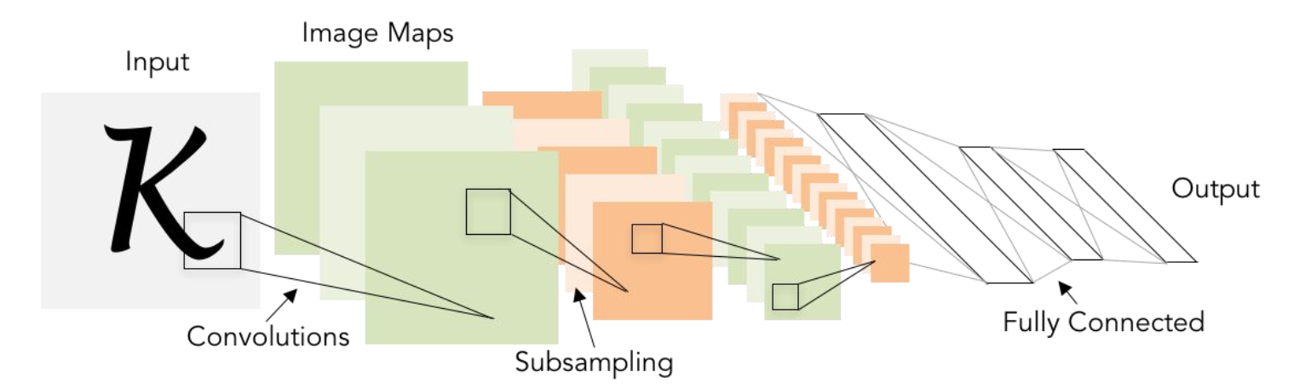
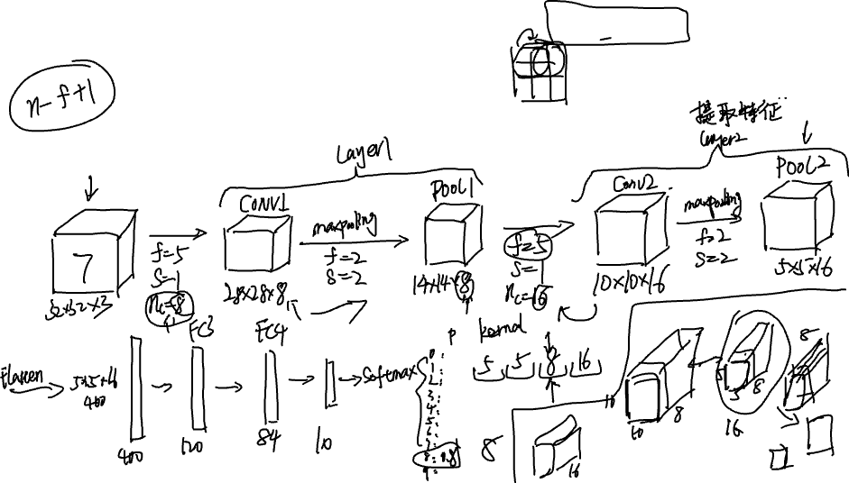
CNN example (An image classifier LeNet-5)

Slide 18
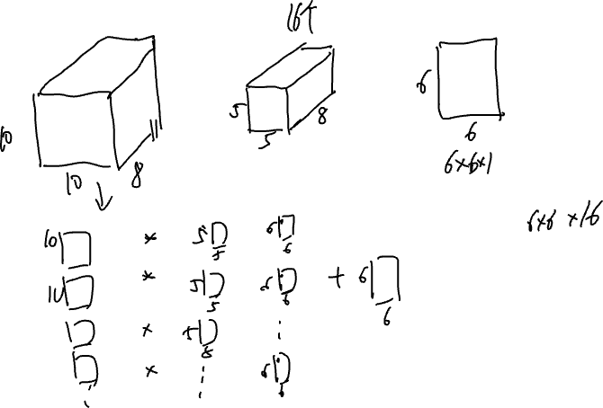

Slide 19
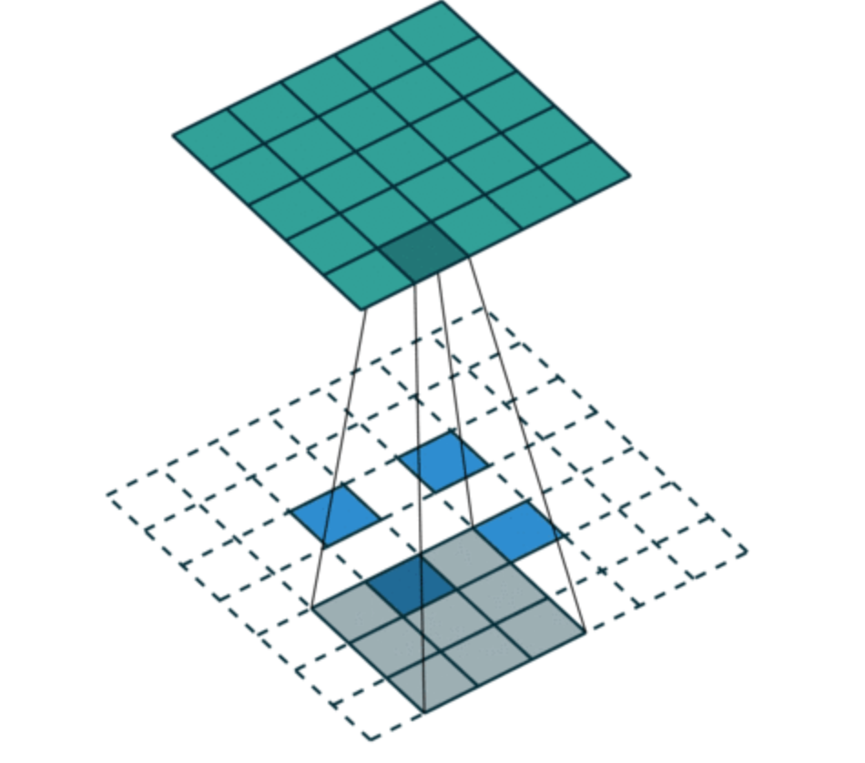
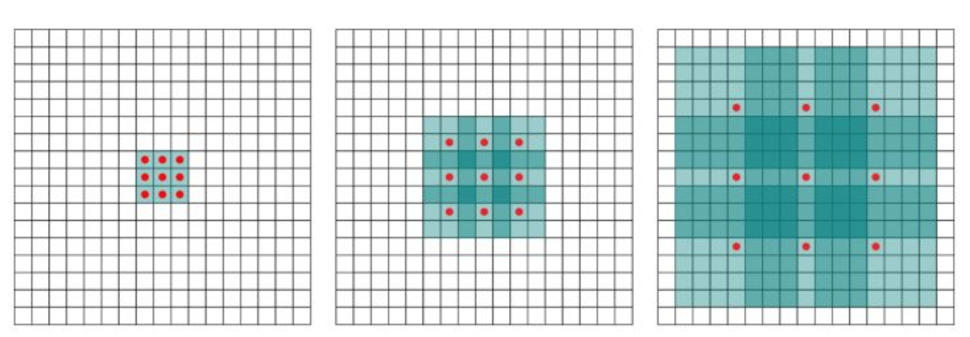
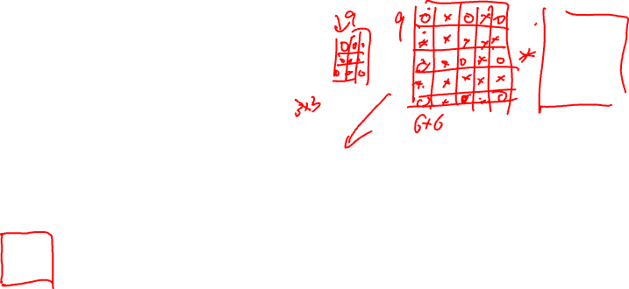
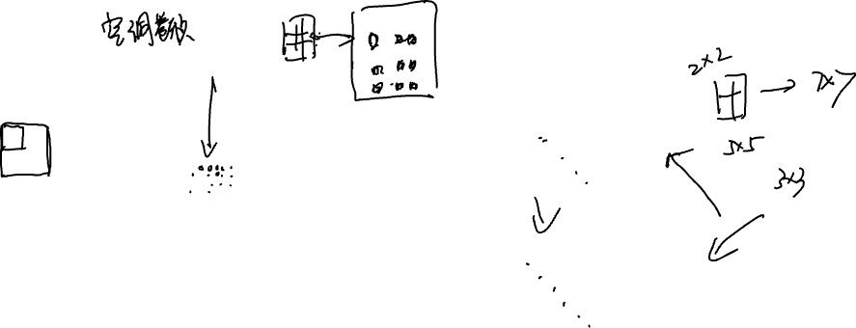
Recent development of CNNs
Dilated/Atrous Convolution
Transposed convolution

Slide 20
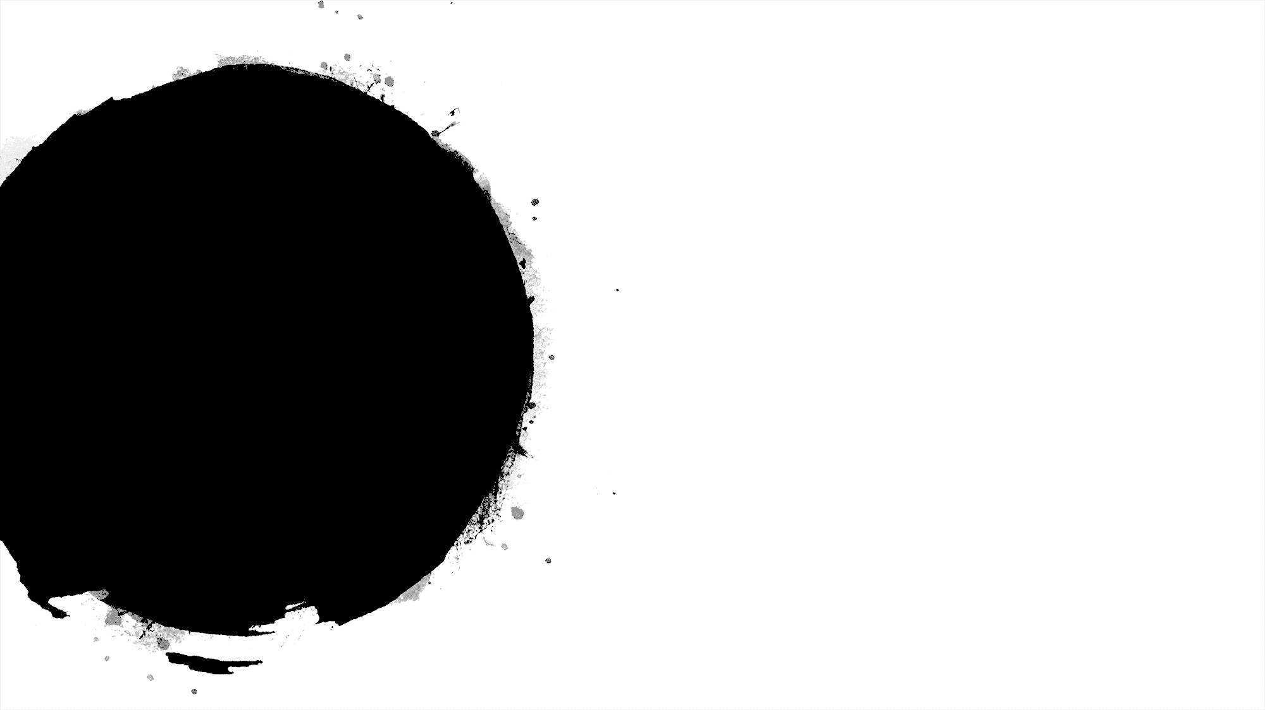

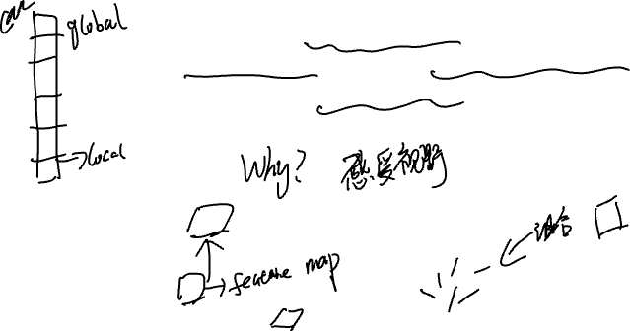
Test your understanding
A lot of experiments show that in a multi layer CNN the local features are captured by lower layers while the global features are learned by higher layers. Can you explain this phenomenon ?

Slide 21
Some famous CNN models

Slide 22
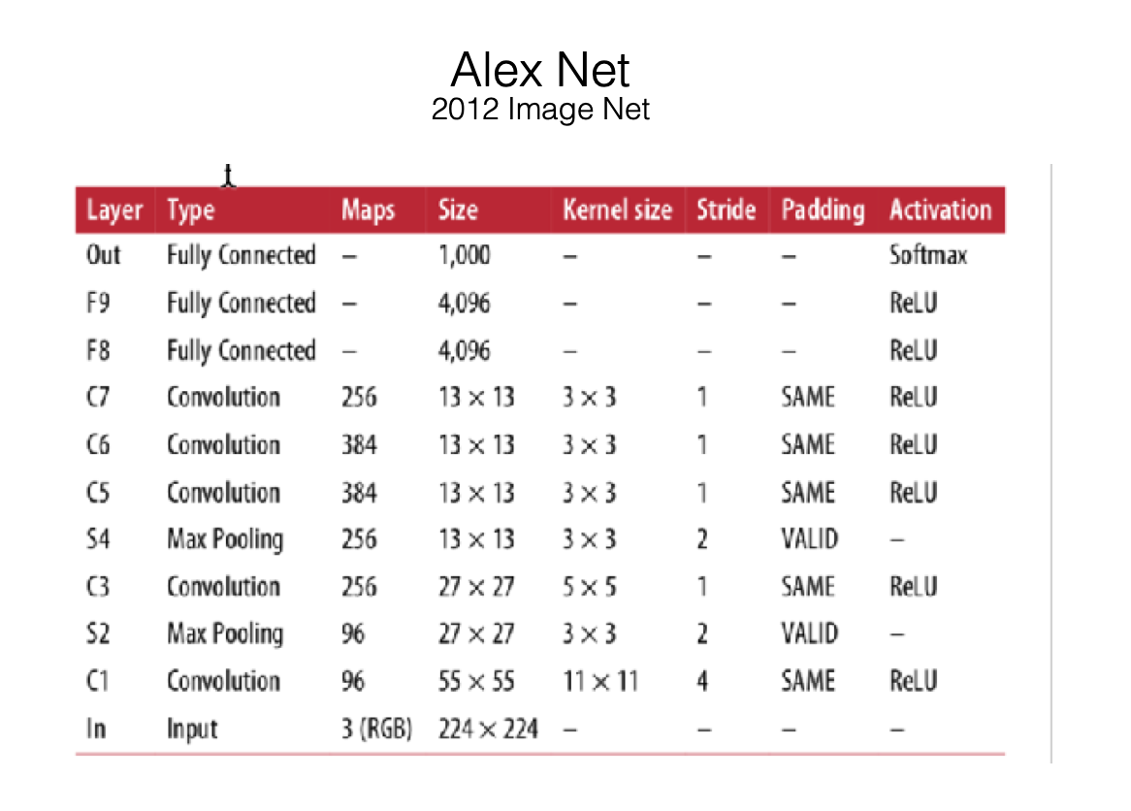
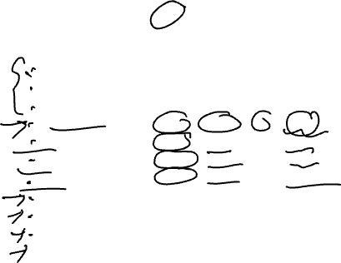
Alex Net

Slide 23
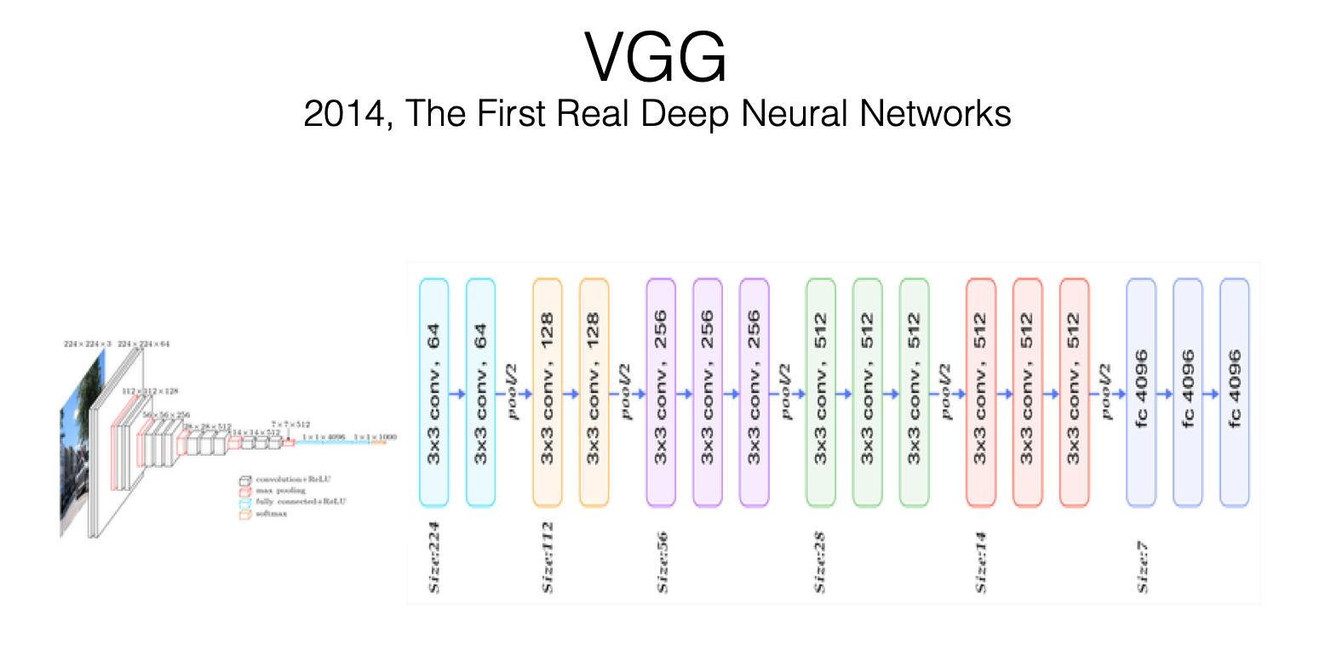
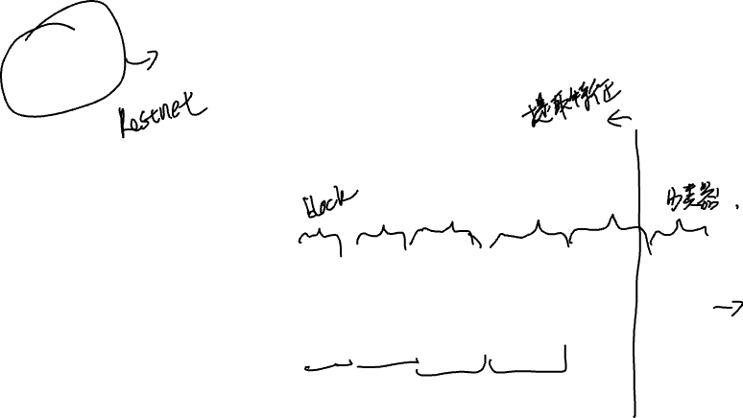
VGG

Slide 24


GoogLeNet

Slide 25



ResNet

Slide 26


Slide 28


TextCNN

Slide 29



Slide 30
Coding session Introduction of Keras

Slide 31

Thanks for attending

